Slide 1

The Ideal Partner for Our Mom
Anufriev Andrew
Kutasov Klim

Slide 2

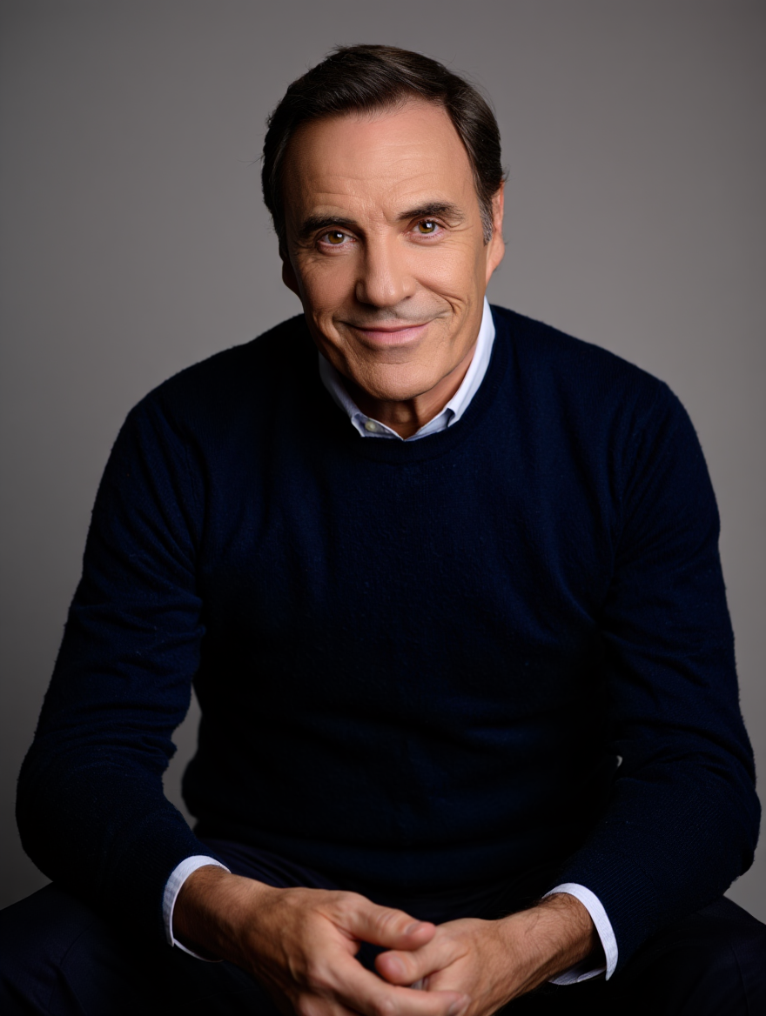
Our mom found herself without a partner, but now that all her children are adults, she has a wonderful opportunity to start a new chapter in her life. I really want to help her with this. I imagine a confident, mature man by her side—someone who, like her, is ready to embrace the future without clinging to the past.
When I think about who would be right for her, I remember that she tried online dating before. Unfortunately, the men she met were not what she was looking for, which was upsetting for her. That experience taught me that appearance isn't the most important thing. At this stage in life, after years of experience, what truly matters is finding a reliable person—someone who is a true partner, not just a passenger.

Slide 3

So, if I were to choose someone for her, I’d probably choose someone who is kind, generous, and funny. He should be a hard-working and reliable person, not lazy. I think a friendly and good listener would be a perfect match for her.
He would probably have a comfortable style - maybe wearing a nice shirt or sweater with jeans, rather than always being in a formal suit.
Would my mom like this person? I truly believe she would. He sounds great because he has the qualities she values most. I'd prefer someone who is a true partner in life, not just a "passenger." This person sounds like the perfect companion for her new beginning.

